Slide 1
11-785: Introduction to Deep Learning Final Project
“Mixture-of-Expert Model for Code Generation”
Team 11
Adithya Kameswara Rao
Santhoshkumar Panneerselvam
Yihao Jia
Yirui Zhu

Slide 2
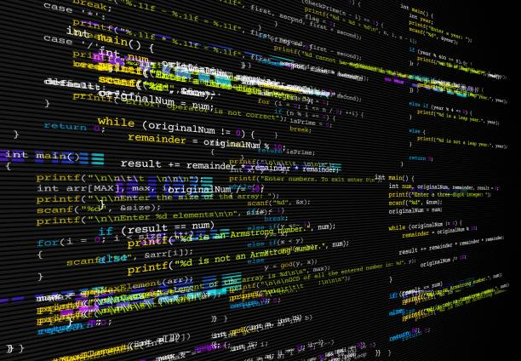
Problem
Multilingual code generation produces code of low quality
Novelty
Monolithic Architecture
Mixture-of-Expert
Significance
Revolutionize coding tools
Speed up software development cycles
Reduce cost
Notes:
Currently, ML-driven multilingual code generation faces a problem of creating low-quality code.
Existing techniques rely on models of monolithic architecture which does not work well. However, our team has created a robust framework that leverages the concept of Mixture-of-Expert. This new solution has greatly improved the accuracy of code generation across multiple programming languages.
Our work is significant because high-quality automated code revolutionizes coding tools, speeds up software development cycles, and reduces costs for tech-driven companies.

Slide 3

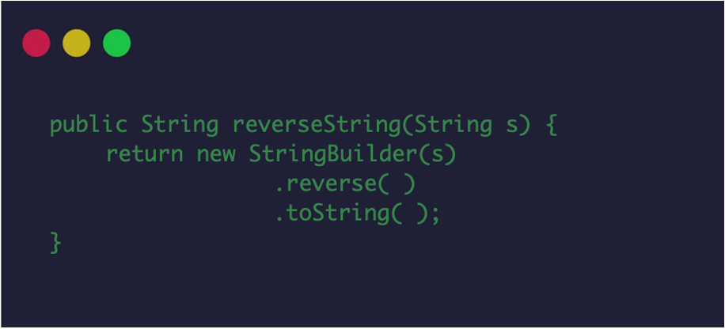
Dataset Overview
Name: codeparrot/xlcost-text-to-cod
Size: 7 programming languages, 10K rows / language
Assumption: Representative of real-world coding task
Transformation: Filter to Python, C++, Java, JavaScript
Write a method to reverse a string in Java.
Notes:
The primary dataset we used was codeparrot/xlcost-text-to-code from hugging face. It contains instruction-code pairs in 7 programming languages with approximately 10K rows per language.
The data is representative of typical coding tasks encountered in real-world software development.
We filtered the data points to four coding languages specifically, which are Python, C++, Java, and JavaScript.

Slide 4
Model Architecture: Mixture-of-Expert
Step 1. Pick A Baseline Model
◦ LLM model with 7B parameters
◦ Computationally efficient
◦ Better than GPT-3.5, Llama 2, etc
Mistral 7B
Notes:
So what on earth is mixture-of-expert?
(Mixture of Expert essentially divides a complex model into smaller models yet with more specialized domain knowledge and then unites them.)
The first step is to choose a complex baseline model. We selected Mistral 7B, a 7–billion-parameter language model, because it excels in computational efficiency and performance, surpassing benchmarks set by models like GPT-3.5 and Llama 2 70B in areas such as code generation and multilingual translation

Slide 5
Model Architecture: Mixture-of-Expert
Step 2. Fine-tuning
Mistral 7B
Mistral 7B Python
Python Dataset
Mistral 7B
Mistral 7B Java
Java Dataset
Mistral 7B
Mistral 7B JavaScript
JavaScript Dataset
Mistral 7B
Mistral 7B C++
C++ Dataset
Notes:
At the second step, we fine-tune the Mistral model based on a subset of our dataset which only contains one of the programming languages and we iterate through all four languages. The purpose of this to create four models that become experts in each of the languages.

Slide 6
Important Techniques
Step 2. Fine-tuning
SFT (Supervised Fine-tuning)
Used to adapt a pre-trained Large Language Model to a specific downstream task using labeled data.
LoRA (Low-Rank Adaption)
Improves the efficiency of fine-tuning by changing the weights for adapter layers while keeping the original model parameters frozen.
Quantization
Represent the models using only 4 bits to reduce size and memory usage, and thus avoid exhausting extensive computational resources.
Notes:
There are three techniques that play an important role during this step:
First, this is a supervised fine-tuning process. It is widely used to adapt a pre-trained Large Language Model to a specific downstream task using labeled data. This process allows the model to learn task-specific patterns and nuances by adapting its parameters according to the specific data distribution and task requirements.
Second, we used Low-Rank adaptation because this technique improves the efficiency of fine-tuning by changing the weights for adapter layers while keeping the original model parameters frozen.
Third, as we know training large language model could exhaust extensive computational resources. So we quantized our models into 4 bits to run in a computationally efficient manner.

Slide 7
Model Architecture: Mixture-of-Expert
Step 3. Merge
Router
Mistral 7B Python
Mistral 7B Java
Mistral 7B JavaScript
Mistral 7B C++
MoE
Notes:
At step 3, we united the expert models into one single model. The architecture also consists of a key component known as the routing network which identifies and selects the most suitable expert model for the input task to yield the corresponding output.

Slide 8
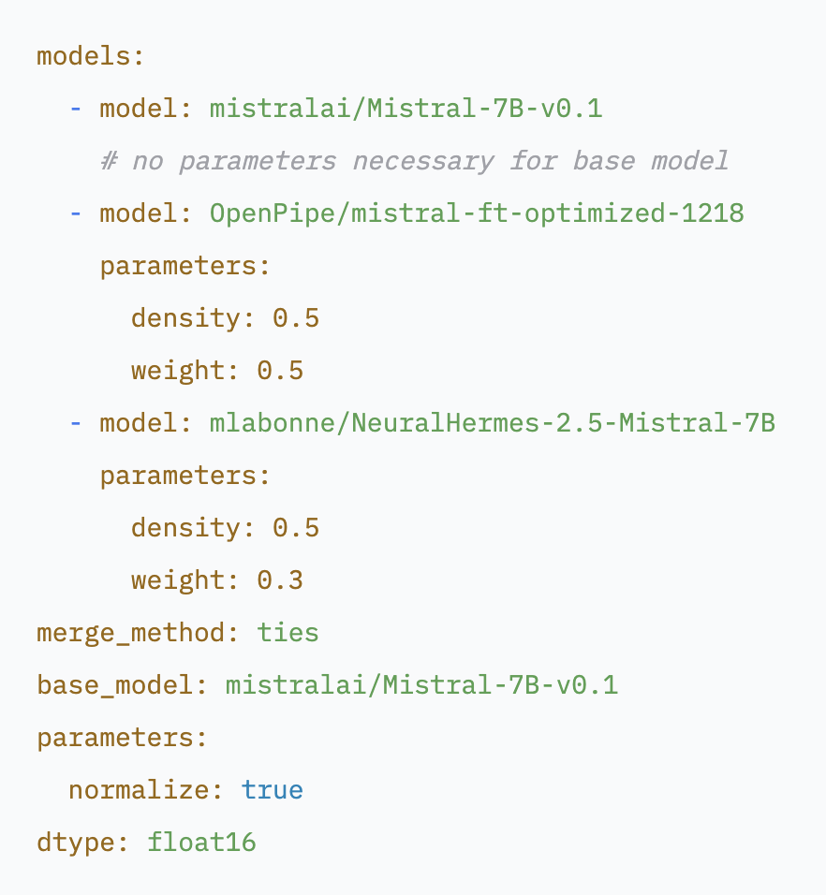
Important Techniques
Step 3. Merge
TIES-Merging
A merging technique designed to efficiently merge multiple task-specific models
into a single multitask model. It addresses two main challenges in model merging:
Redundancy in model parameters
Disagreement between parameter signs
Steps:
Trim
Elect Sign
Disjoint Merge
Advantage:
Merge multiple models at a time
Notes:
We use a technique called TIES-Merging which is designed to efficiently merge multiple task-specific models into a single multitask model. It addresses two main challenges in model merging:
- Redundancy in model parameters: It identifies and eliminates redundant parameters within task-specific models. This is achieved by focusing on the changes made during fine-tuning, identifying the top-k% most significant changes, and discarding the rest.
- Disagreement between parameter signs: Conflicts arise when different models suggest opposing adjustments to the same parameter. TIES-Merging resolves these conflicts by creating a unified sign vector that represents the most dominant direction of change across all models.
TIES-Merging is divided into the following three steps:
1. Trim: Reduces redundancy in task-specific models by retaining only a fraction the most significant parameters (density parameter) and resetting the rest to zero.
2. Elect Sign: Resolves sign conflicts across different models by creating a unified sign vector based on the most dominant direction (positive or negative) in terms of cumulative magnitude.
3. Disjoint Merge: Averages parameter values that align with the unified sign vector, excluding zero values.
Unlike other methods, TIES can merge multiple models at a time.

Slide 9
Model Architecture: Mixture-of-Expert
Router
Mistral 7B Python
Mistral 7B Java
Create a function to calculate factorial in Python
Mistral 7B JavaScript
Mistral 7B C++
MoE
Notes:
When we feed a prompt that expects a Python code snippet into the MoE model, the router selects the Python expert model and produces the correct output.

Slide 10
Model Architecture: Mixture-of-Expert
Router
Mistral 7B Python
Mistral 7B Java
Create a function to calculate factorial in Python
Mistral 7B JavaScript
Mistral 7B C++
MoE
Notes:
When we feed a prompt that expects a Python code snippet into the MoE model, the router selects the Python expert model and produces the correct output.

Slide 11
Model Architecture: Mixture-of-Expert
Router
Mistral 7B Python
def factorial(n):
return 1
if n == 0
else n * factorial(n - 1)
Mistral 7B Java
Create a function to calculate factorial in Python
Mistral 7B JavaScript
Mistral 7B C++
MoE
Notes:
When we feed a prompt that expects a Python code snippet into the MoE model, the router selects the Python expert model and produces the correct output.

Slide 12
Results
Metrics: CodeBLEU
Calculate the weighted n-gram
match score given the output and
the reference solution.
Findings:
High performance in Python, Java, JavasScript. Why?
Consistent Language Structure
Verbose and explicit syntax
C++ expert model did not improve as much as anticipated. Why?
Language complexity
Overloaded syntax
Error Propensity
MoE achieved high overall score
Mistral 7B
0.1660
Language | Baseline | Finetuned
Python | 0.1800 | 0.4000
Java | 0.1860 | 0.4287
JavaScript | 0.1909 | 0.4182
C++ | 0.2170 | 0.3440
Mixture-of-Expert
X

Slide 13

Conclusion
Takeaways
The MoE model excels in code generation, notably improving output for multiple languages.
Expert networks provide language-specific expertise, especially enhancing Python and Java code quality.
Real-World Impact
MoE models streamline code generation, offering time and cost savings in software development.
Broader access to MoE technology could catalyze innovation across various industries.
Future Work
Focus on refining C++ and other underperforming language models.
Expand MoE to cover more programming languages for wider use.
Notes:
Takeaways:
- The MoE model excels in code generation, notably improving output for multiple languages.
- Expert networks provide language-specific expertise, especially enhancing Python and Java code quality.
Real-World Impact:
- MoE models streamline code generation, offering time and cost savings in software development.
- Broader access to MoE technology could catalyze innovation across various industries.
Future Directions:
- Focus on refining C++ and other underperforming language models.
- Expand MoE to cover more programming languages for wider use.

